Slide 1

Gender Classification
Computer Vision Course
Andrei Paraschiv, An I Master AI

Slide 2

Gender Classification
Project description
Technologies used
Identify Gender by the features in the face of humans
Dataset used – Images scraped from Wikipedia, gender labeled
Keras+Tensorflow, Python
Face detection using OpenCV
Training images (faces) cropped and resized to 96x96 px
Data split - 80 training - 20 test
50 epochs
Trained model tested on 35.000 images

Slide 3
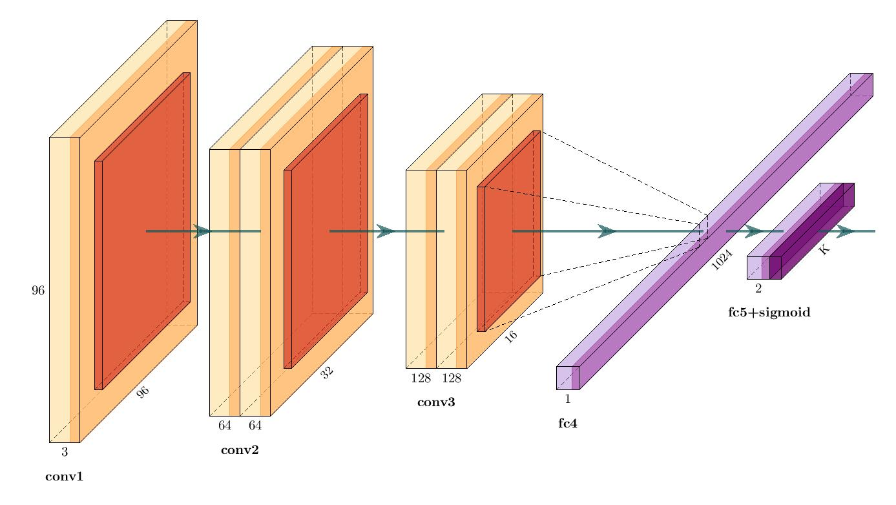
Simplified VGG
Conv 1 – one CNN, 32 filter/ 3x3 kernel
Conv 2 – two CNN, 64 filter/ 3x3 kernel
Conv 3 – two CNN, 128 filter/3x3 kernel
Fully Connected 1024
Sigmoid

Slide 4
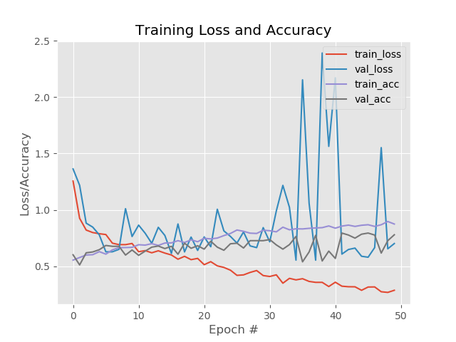
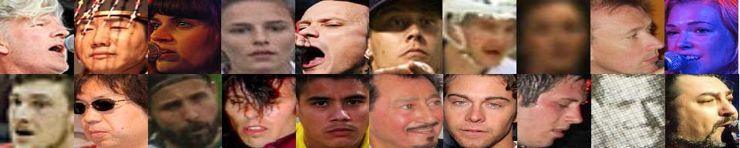
Experiment 1
1000
78 %
93 %
79 %
images
Accuracy
Precision
Recall
Sample misclassified images:

Slide 5
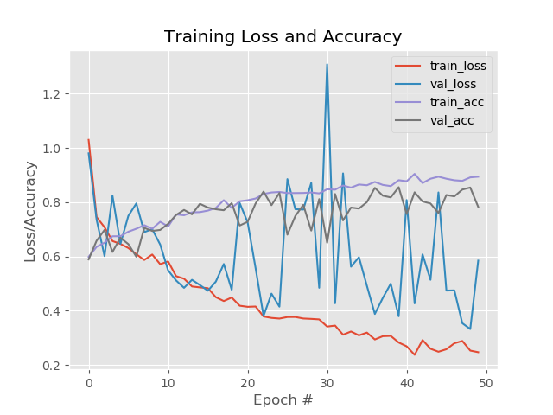
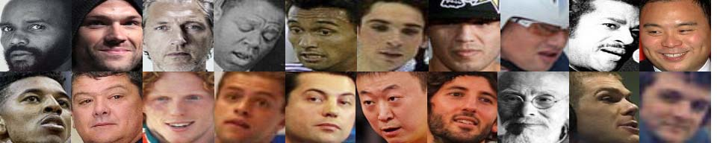
Experiment 2
2000
67 %
59 %
96 %
images
Accuracy
Precision
Recall
Sample misclassified images:

Slide 6
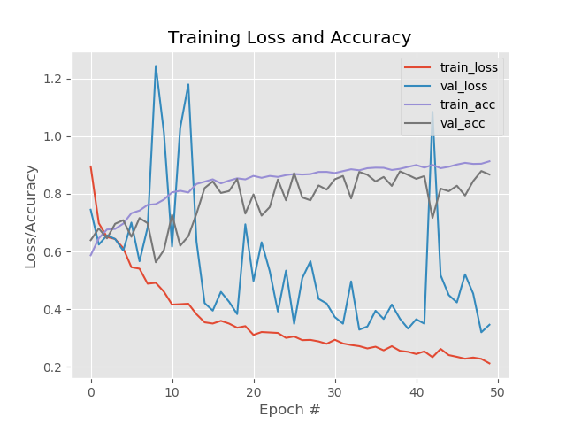
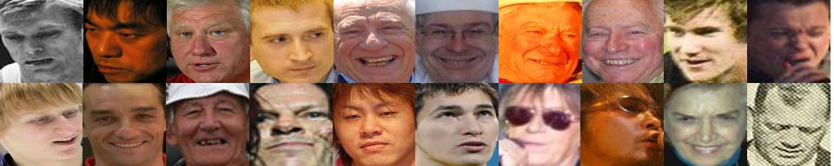
Experiment 3
5000
86 %
88 %
96 %
images
Accuracy
Precision
Recall
Sample misclassified images:

Slide 7
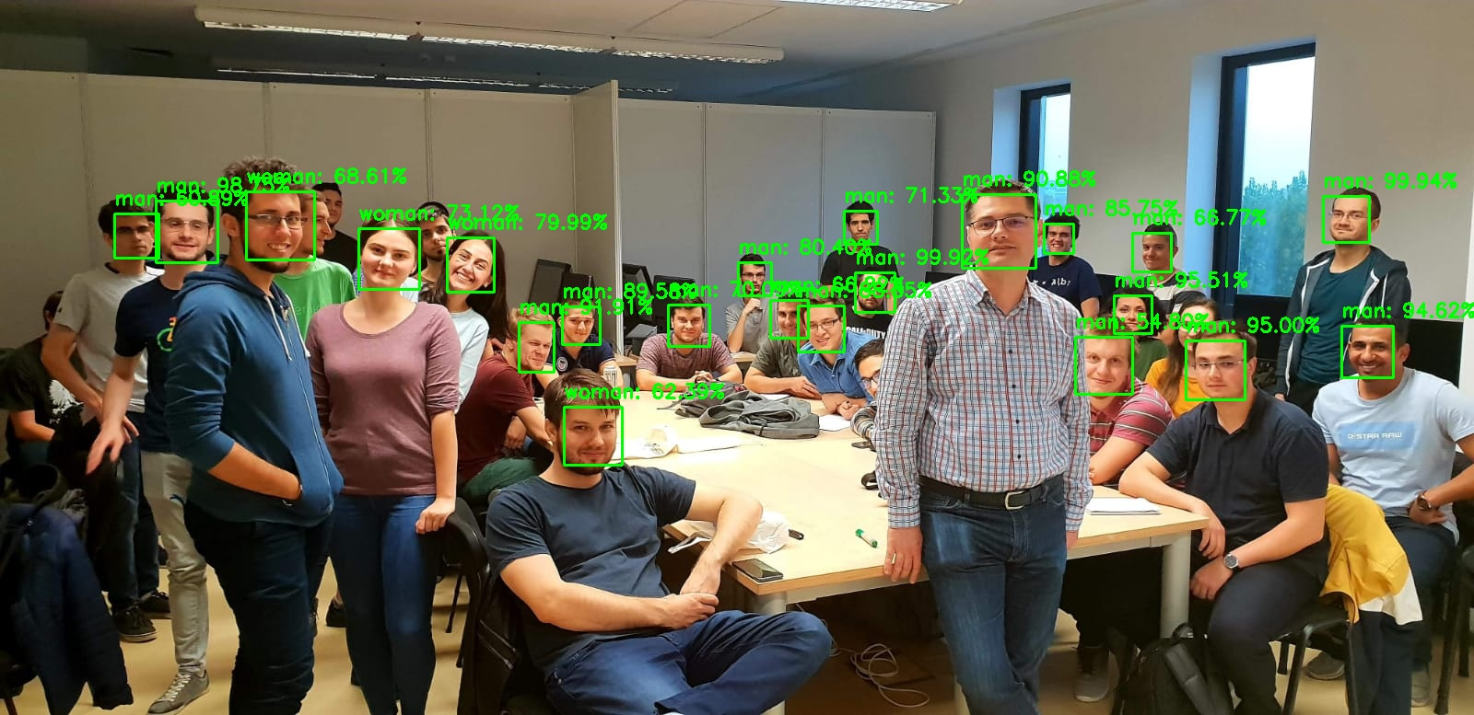
AAAAND… it’s working...
...in most cases :)

Slide 8

Apologies to the misclassified colleagues

